Slide 1
Putting Patients (and Our Values) First

Slide 3
#PutPatientsFirst Growth Over Time

Slide 4
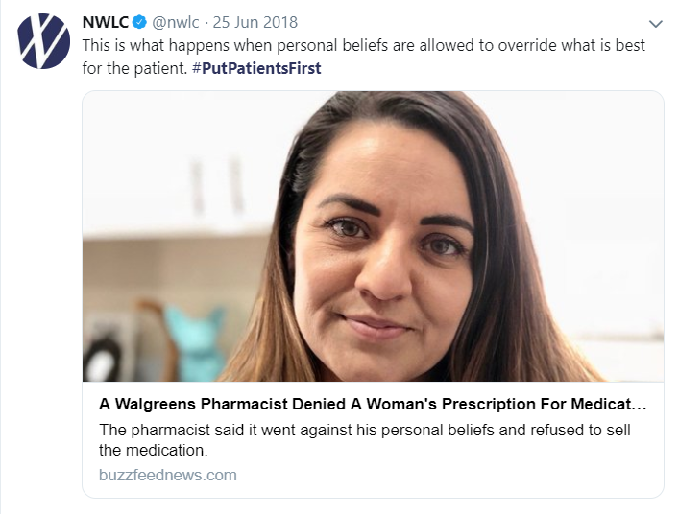
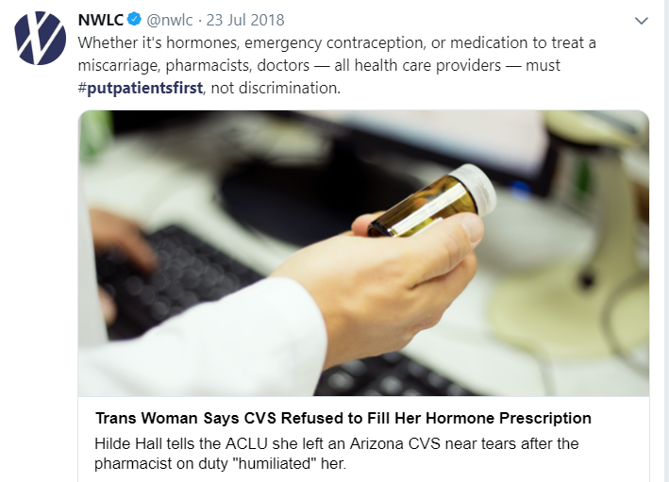
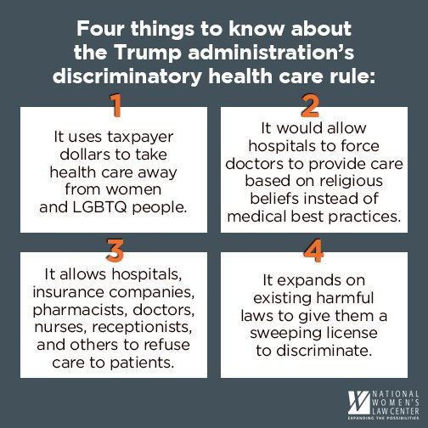
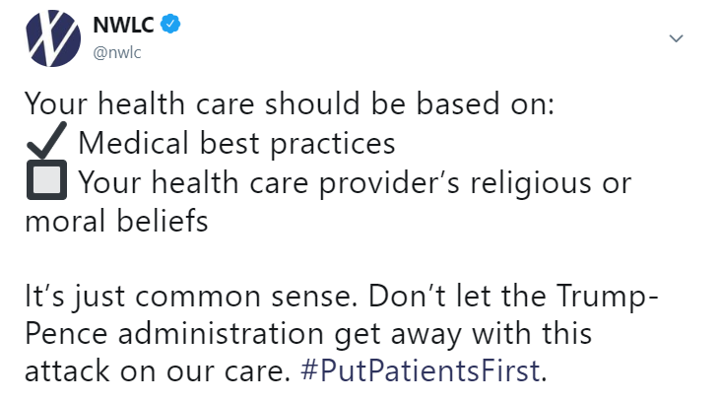
Hundreds of millions of potential impressions
Tens of thousands participating in online conversations
22,294 comments submitted

