Slide 1
Sarah Hassmer National Women’s Law Center
SETTING FAMILIES IN THE LOW-WAGE WORKFORCE UP FOR SUCCESS: REIMAGINING WORK & INCOME SUPPORTS

Slide 3
SETTING FAMILIES IN THE LOW-WAGE WORKFORCE UP FOR SUCCESS: REIMAGINING WORK & INCOME SUPPORTS

Slide 4
Family tax credits
Families face rising costs for child and dependent care, housing, and more
Stagnant wages
Nearly 1/3 of women working in low-wage jobs are mothers of children under 18
Alleviate regressive state tax codes
Lift families out of poverty
Improve children’s health and education outcomes
Boost for local economies

Slide 5
Earned Income Tax Credit (EITC)
Lifts millions of families out of poverty
Incentivizes and supports work, in turn boosting future retirement benefits
Complements increases to the minimum wage to help low-income workers make ends meet
28 states and D.C. offer an EITC (23 refundable)
State EITCs are often based on a percentage of the federal EITC

Slide 6
Child and dependent care tax provisions
Tax benefit for families who pay out-of-pocket, work-related expenses for child and dependent care
23 states and D.C. offer credits (12 refundable)
5 states have deductions
Principles
Pair with robust direct child care assistance
Refundable credit
Generous expense limits
More generous for lower-income families

Slide 7
Child Tax Credit (CTC)
Refundable CTCs can help reduce child poverty rates
6 states offer a child tax provision
2 refundable credits (CA, NY)
2 nonrefundable credits (ID, OK)
1 deduction (NC)
1 one-time child tax rebate (WI)
Credit Design Option Examples
Fixed amount per child
Percentage of the federal CTC
Greater of a fixed amount or a percentage of the federal CTC

Slide 8
Impact of Refundability
Many low-income families do not have enough tax liability to receive the full value of non-refundable credits or deductions (if at all)
Refundable tax credits promote more equitable distribution of tax benefits
Example:
Source: NWLC Calculations based on State of California Franchise Tax Board Data

Slide 9
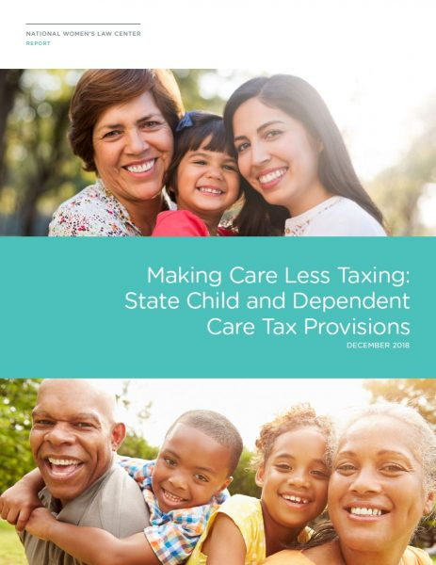
Resources for You
State Playbook for Gender Equity policy element fact sheet on state tax credits for low-income families, available at https://nwlc.org/resources/state-policy-elements/
Making Care Less Taxing report and additional resources on child and dependent care tax provisions, available at https://nwlc.org/resources/mclt/
Email shassmer@nwlc.org

